Slide 1
THE DEVELOPMENT AND MEASUREMENT OF ATTUNEMENT AMONG ADULTS IN THE YOUTH MENTORING SYSTEM Involve Conference, Wellington, NZ August 14, 2018
Julia Pryce, Ph.D., LCSW
In collaboration with community partners,
Linda Gilkerson, Ph.D., & Kelsey Deane, Ph.D.

Slide 2
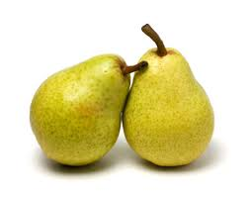
Pair and share
What has the day been like for you so far?
What has the day been like for you so far?
Notes:
What was that like to be asked about your experience?
What was it like to offer your presence to the other?
What did you learn about your partner?

Slide 3
Our Time Together
Photo Credit: http://www.clker.com/clipart-checklist-form.html
Introduction of key concepts
--Attunement
--Mentoring FAN
Overview of findings from work with agencies on Mentoring FAN training
Introduction of Mentor Attunement Scale (MAS)
Q & A and wrap up

Slide 4
Practicing Presence

Slide 5
What we know from research and practice
Relationships are central–
“We say this program is all about relationships, but we don’t often talk about how to do that, to create the relationships we so value. This process finally gives us a way to think about & practice that.”
Better understanding of relationship process holds promise for more effective intervention (Keller, 2005)
Photo credit: http://www.pdx.edu/youth-mentoring/diversity-in-youth-mentoring-relationships

Slide 6
Definition of Attunement (Pryce, 2012)
Capacity to respond flexibly to verbal and nonverbal cues by taking into account others’ needs and desires
Represents broad strategy to elicit, read, interpret and reflect on others’ cues
Requires adaptation of expectations based on others’ interests
Involves level of intentionality in approve toward building the relationship
Notes:
Photo Credit: http://www.babaylanadlaw.com/p/reiki-attunement.htm

Slide 7
Attunement as Theory of Change
“When someone feels truly understood, “known,” the attunement that occurs creates a space where it is possible to try new ways of interacting.”
Siegel & Hartzell, 2003 in Lewis, 2011, p. 446.
Photo Credit:
https://www.hearfoundation.org/hear-foundation-mentoring-program/
Notes:
Here is the FAN theory of change
When someone feels truly understood---known—the attunement that occurs creates a space where it is possible to try new ways of interacting.
Attunement opens the space for change.
When people feel connected and understood, they feel safer, more open, and able to use the relationship for growth.

Slide 8
Initial Observed Attunement of Mentors
Category | Characteristics
Highly Attuned (40%) | Consistently seeks to attend flexibly and creatively to verbal or nonverbal signs as to preferences, concerns, feelings
Moderately Attuned (45%) | Although generally attuned, attention and flexibility varies due to challenges connecting with other, involvement with other group members, or lack of program support.
Minimally Attuned (15%) | Slow or unable to adjust approach based on verbal or nonverbal signs as to preferences, concerns, or feelings.

Slide 9
Fussy Baby Network®
National model prevention program
FAN Approach to Family Engagement and Reflective Practice (Gilkerson & Gray, 2013; Gilkerson et al, 2013).
International Network
FAN approach applicable to communication and engagement processes across settings
Notes:
Fussy Baby Network is a national model home visiting program started in Chicago that serves families from birth to one year. The FAN is the approach to family engagement and reflective practice that was first developed at the Fussy Baby program for working with fussy babies and families. Linda Gilkerson, a professor at Erikson, is the Executive Director of Fussy Baby Network and developer of the FAN.
The FAN approach is generalizable beyond infant fussiness and is now used widely in home visitation programs and in training pediatricians, early intervention providers, early childhood mental health clinicians, and even lawyers, judges and staff and volunteer mentors in youth development programs!
You can learn more about Fussy Baby and FAN at Erikson’s Website ( See on the slide).
Let’s take a moment and consider how the work with fussy babies shaped the FAN approach.

Slide 10
Mentoring FAN: “How you do the work” PLEASE EMAIL jpryce@luc.edu IF YOU ARE INTERESTED IN THIS MODEL
Notes:
DO NOT REPRODUCE WITHOUT PERMISSION

Slide 11
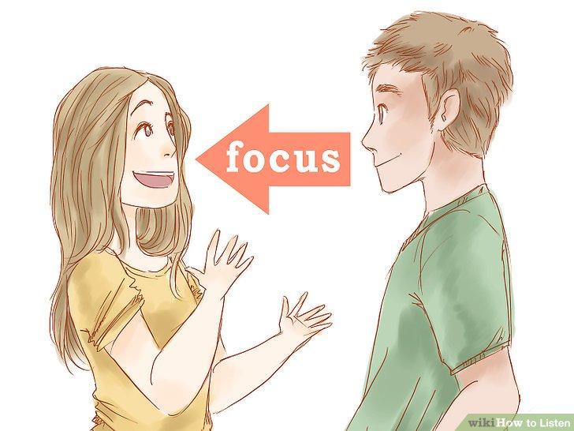
FAN Matching Process during interaction
Observe/Listen For Cues
What is the person showing me in the moment?
Offer
Which core process matches their cues?
Check the Match
Is this working?
If you are in the right FAN wedge, should be “flowing”
Re-attune
Move on the FAN based on the other’s response
Notes:
LG

Slide 12
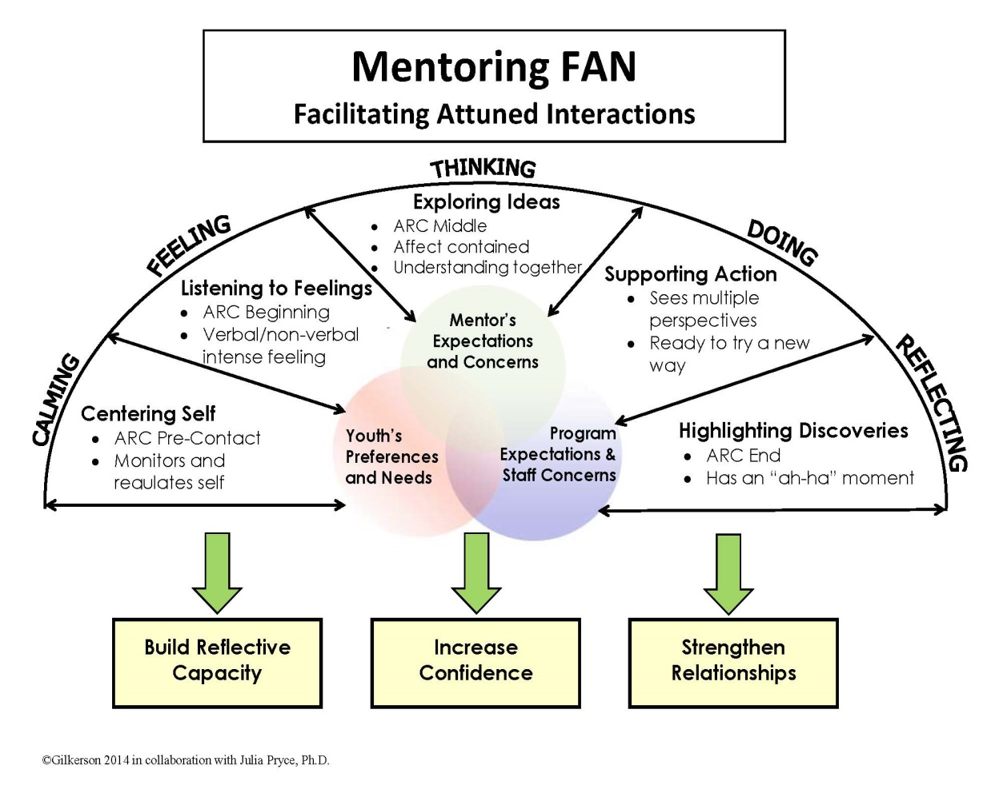
FAN Interactions vs Moments
Interaction refers to contact that allows for entire FAN process to take place
FAN Moments refer to brief encounters where FAN skills can be useful
FAN Moments

Slide 13
http://www.advancedfamilyvisioncare.com/about/schedule-appointment/
Take A Peek…
Cues Related to the FAN Core Processes
MENTORING FAN HELPS YOU READ CUES AND MATCH WITH OTHERS

Slide 14
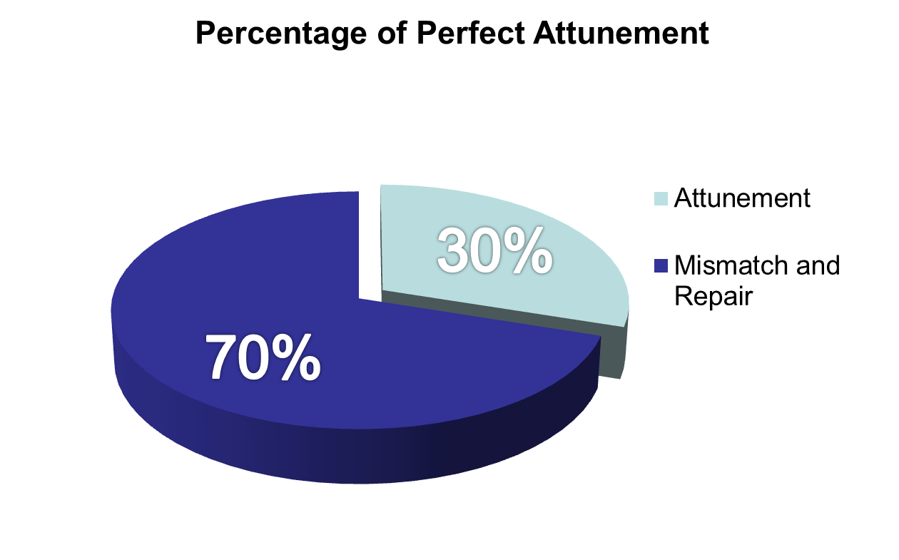
“When you do something that doesn’t work, you have an opportunity to learn something and grow closer.” Dr. Brazelton
Notes:
“When you do something that doesn’t work, you have an opportunity to learn something and grow closer.” –T. Berry Brazelton, MD​
Facilitating repair can strengthen the relationship and offer a corrective experience.

Slide 15
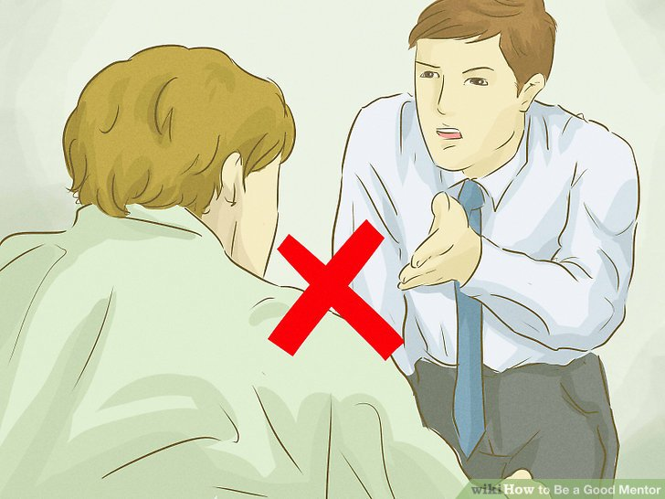
Misattunement
Photo Credit:
https://www.wikihow.com/Be-a-Good-Mentor
Pacing​
moving too quickly​
moving too slowly​
Cultural Misattunement​
Pushing our agenda and jumping to doing​
Other common kinds of or reasons for misattunement and disconnect?

Slide 16
Your Mismatch Story
Think of an interaction that you had with someone that didn’t go so well, ideally in professional context
Draw a picture of this interaction in your mind so you can come back to it
Share with colleague:
What were you needing?
What actually happened?
How did it feel for you?

Slide 17
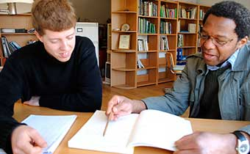
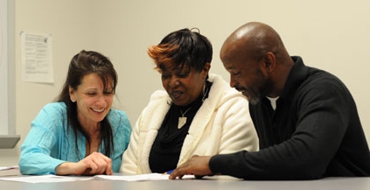
Staff reflections on importance of attunement
“I was able to grow just in terms of really attending to the mentor. I developed a real intentionality about observing their cues & asking probing questions, depending on where they are. I became a better listener in the process.”
“I think we have a tendency to jump to the fixing maybe quicker than this model would like for us to do.”
“I think I really reflected on what were they feeling, what was going on with them and the student, how can I be a support to that?”

Slide 18
Pair & Share on FAN
What might be your comfort wedge?
Where is your growing wedge?
In your team of colleagues/program, comfort or growth areas?
From what you know about the FAN, what way might you shift your approach to increase attunement?
Notes:
Individual goals:​
Where is your comfort wedge? Where is your growing wedge?​
Team goal:​
As a team, where is your comfort wedge? Your growing wedge? ​

Slide 19
Empathic Inquiry: Example
“First she wanted to explain everything and defend herself and she’s obviously not in a position yet to move forward with me to try and solve the problem. She was in that processing stage where all of us get where someone thinks we’ve done something wrong and that makes us feel uncomfortable. [FAN] enabled me to hear more: “Ok she is not yet ready for us to move into this, what is it going to look like next stage. I need to just let her vent some.”
- Sara, Site Coordinator
Notes:
LG

Slide 20
Empathic Response? Yes or No
“I think I’m ready to give up.”
Sounds like things have been really rough.
Don’t give up. You will make it through this.
Hang in there.
It must feel hard sometimes.
What do you mean when you say that?
I know you are committed as a mentor.
I hear you. Can you say more?
Notes:
Let’s focus on holding, validating, and exploring to start. Let’s look at some different responses and see what you think. Are these empathic inquiry statements? Which ones are/are not?
Depending on the group size, invite people to do thumbs up or thumbs down – exploring thoughts and differences.

Slide 21
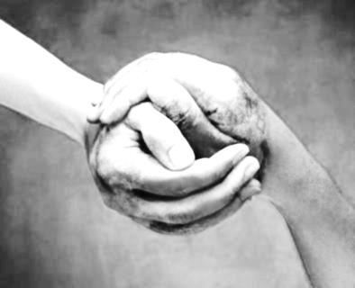
Strategies for Empathic Inquiry
Holding Feelings
Listening with compassion and acceptance: just letting it be shared
Exploring Feeling
What did it feel like for you when that happened? about that?
That sounds really difficult. Would you like to talk more
Validating Feelings
I can hear how worried you are about your mentor.
You are working so hard to figure this out.
Containing Feelings
I can imagine this feels overwhelming. Did you see any glimmers of hope in this situation?
I hear how concerned you are. I’m wondering if there has been a time when things went differently?
We’ve had a while to think about how stressful this is. Do you think you have the space now to move into thinking about what you’d like to do?

Slide 22
Pair and Share
Think of times your mentor, colleague, or mentee/youth that you know was in FEELINGS
Write two empathic statements that validate or explore the feelings
Share with partner
Group discussion
Notes:
LG

Slide 23
Findings on training of mentoring staff
Statistically significant differences in staff interpersonal reactivity: t(28) = -2.22, p=.04.
Statistically significant differences in staff ability to self-reflect, and increased level of insight regarding work
t(9) = -2.77, p = .024; t(9) = -4.10, p=.003.
Measures of empathy and
mindfulness yielded positive trends
Staff self-reported growth in ability to be
empathic and self-aware, and an increased
use and comfort in employing mindfulness
practice techniques
Notes:
Assessed via Interpersonal Reactivity Index (IRI; Davis, 1983).
Participant self-report on four subscales: perspective taking, fantasy (i.e., identifying with characters in a novel), empathic concern, personal distress (i.e., personal feelings of apprehension in emergency situations).

Slide 24
Qualitative findings
Photo Credit:
https://growthfreaks.com/active-listening-skills/
Central Themes from Interviews
Attunement: Listening and reading cues
I was able to grow just in terms of really attending to the mentor. I developed a real intentionality about observing their cues, um, and asking more probing questions depending on where they’re at. I came to a place where I can really sort of watch them. I guess I became a better listener in the process. Just thinking more about where they’re at and what they’re ready for before I begin to provide feedback… provide guidance, provide suggestions, um, and observe where they’re at before I jump into those things.
- Tyrone
Notes:
34 semi-structured interviews (30-40 mins long)
7 community partner sites
traditional one-to-one mentoring, school- and site-based mentoring, mentoring of youth involved in child welfare, mentoring in community colleges and of college students
Questions on
participants’ overall experience using the Mentoring FAN
helpful and hindering aspects of utilizing approach
barriers perceived to implementing Mentoring FAN in their practice
suggestions for improving future trainings

Slide 25
Qualitative findings (cont).
Attunement: Awareness of self and other
But now I’m much more conscious of what other people in the situation are thinking or feeling. Um, and allowing them to not only share their ideas, but implementing their ideas as effective as mine would be…[the FAN] allows me to take a step back and be empathetic that not everybody thinks or feels the way that I think. -Kelly
Supervision as a collaborative relationship: shift in nature of supervision from hierarchical problem-solving to collaborative exploration
…I think before [FAN training] I kind of took on more of a teacher role and I would tell them, ‘you know, maybe you should do this or that, and now, I just kind of let them be and let them try to figure it out instead of always try to solve everything. doing the FAN has allowed me to see them [the mentors] in a little bit of a different role. Before, they were my mentors and I would tell them what to do and they would just do it…and now it’s like we’re working together.
-Amanda

Slide 26
Qualitative findings (cont).
Improved ability to support relationships between mentors and youth: As staff developed skills in attunement, more able to understand the mentors and mentoring relationships
Just working with that mentor and not um, giving up…there were very many times when I know he wanted to give up, and I kind of wanted to terminate the match because of the frustration I was feeling because of the mentor. Meeting together, problem solving to think of solutions, and just affirming his worth, his value in the relationship, really helped change the relationship.
-Charlotte
Increased sense of staff purpose in work supporting mentors
Mentor feedback further reinforces the strengthening of connection between staff and mentors as associated with Mentoring FAN training

Slide 27
Process Evaluation Data
Mentoring FAN Post-Contact Reflection Tool
self-report process evaluation data collected from sites during the practice phase
Results from open- and closed-ended questions showed trends of increased confidence of staff and self-awareness (ability to identify own feelings and feelings of mentors they support), and increased use of tool over time

Slide 28
Findings to date from mentor feedback
Strengthening of relationship between staff and mentor
The opportunity for more in-depth conversation with my site coordinator has also led to other more in-depth conversations about personal lives, which has allowed us to get to know each other better and develop a relationship, which I think aids in the retention of mentors to the program.
Increased use of self-reflection
Conversations helped because it provided me as a mentor the opportunity to stop and reflect upon my interactions with my mentee, which allowed me to recognize the changes that were occurring in our relationship.
Opportunities for staff to reflect with the mentor and highlight strengths and successes
Our extended conversations have given me the confidence and sense of ownership in what I’m doing.
Notes:
Mentors supported by staff completed anonymous, open-ended questions focused on experience of support by staff participants in Mentoring FAN

Slide 29
Findings on training of mentors
Enhanced listening skills
Increased attention to balance of curriculum content and relationship development
Increased use of calming practices during stressful interactions with mentee

Slide 30
Overview of partner agencies to date
School-Based Mentoring of Champaign/Urbana
Big Brothers/Big Sisters of Dallas
Spark Chicago
DePaul University Cities Mentor Project
Higher Education Mentoring Initiative
Read Ahead New York City
Arrupe College Chicago

Slide 31
Overview of Training Structure
First level training:
One day training on Mentoring FAN
5 month follow up (which included monthly calls or meetings used to practice Mentoring FAN)
Can consider virtual training as well to accommodate New Zealand context
Train-the-trainer option
Trainer participates in first level training
Trainer conducts Mentoring FAN trainings and is observed and receives feedback

Slide 32
Overview of findings from trainings
Feedback from one day training across two cases
Overall Mentoring FAN Training consistently well received
86% of participants rated training as helpful or very helpful (4.4/5 on average rating across evaluation)
“The materials provided were clear and engaging and eye-opening. The training was clearly well thought-out and organized. I appreciated the variation in activities. Great experiential learning.”
“I will find the time for this! This will really make a difference!”
Most helpful aspects of training include:
Focus on Mentoring Relationships
FAN Matching Process and Self-Awareness
Attention to Mindful Self-Regulation
Shift of focus to collaboration
ARC of Engagement as tool

Slide 33
Reactions? Questions? Anticipated Challenges? One idea you would like to remember from the Mentoring FAN? What will you take with you?
Photo Credit: http://iteachblogging.com/share-your-idea/

Slide 34
Measurement and monitoring of attunement (Pryce & Deane, in preparation)
Notes:
DO NOT REPRODUCE WITHOUT PERMISSION

Slide 35
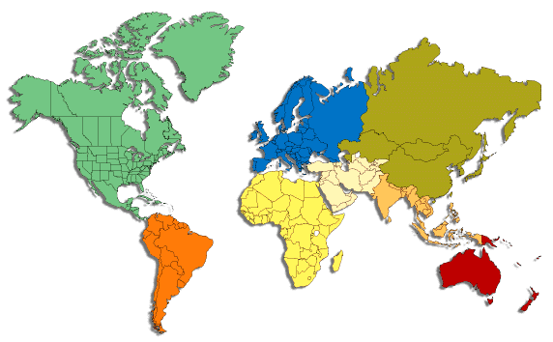
Next steps in measuring attunement
Analyzing scale from current U.S. based sample (n = 405); promising findings to date
Piloting of scale with mentors in India-based sample and exploration of role of attunement in predicting match quality and potentially correlating with empathy
Interest in ongoing cross-cultural work so field can use measure to screen and support mentors and staff
Check in after workshop if curious!

Slide 36
Wrap-Up
Final questions and considerations
Notes:
JP

